Slide 1
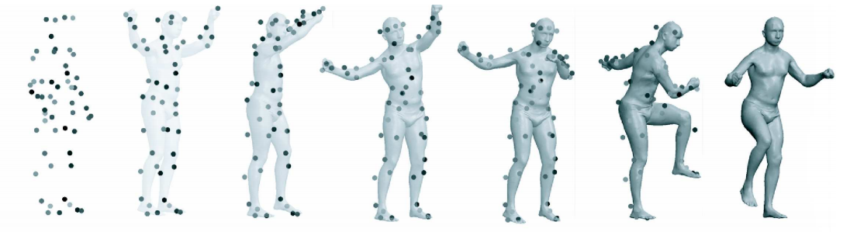
SCAPE: Shape Completion and Animation of People

Slide 2
Introduction
Graphics applications often require a complete surface model for rendering and animation.
Obtaining a complete model of a particular person is often difficult or impossible.
SCAPE — a data-driven method for building a unified model of human shape.

Slide 3
Introduction
Key features of the method :
This method learns separate models of body deformation — one accounting for changes in pose and one accounting for differences in body shape between humans.
The model provide a level of detail sufficient to produce dense full body meshes, and capture details such as muscle deformations of the body in different poses.
Applied to two main tasks :
Partial view completion
Full 3D animation of human

Slide 4
Pipeline
Acquiring and Processing Data Meshes
Pose Deformation
Body-Shape Deformation
Shape Completion

Slide 5
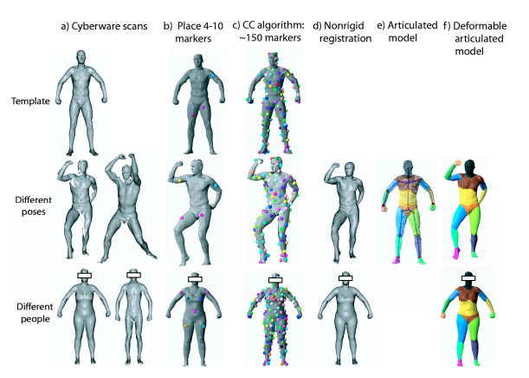
Acquiring and Preprocessing Meshes

Slide 6
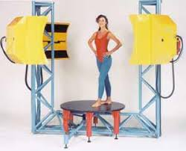
Acquiring and Preprocessing Meshes
Range Scanning
Surface data is acquired using a Cyberware WBX whole-body scanner.
The scanner captures range scans from four directions simultaneously.
Two data sets are obtained:
Pose data set : scans of 70 poses of
particular person in a wide variety of
poses.
Body data set : scans of 37 different
people in a similar (but not identical)
pose.

Slide 7
Acquiring and Preprocessing Meshes
Range Scanning
One mesh is selected from the pose data as the Template Mesh.
All other meshes are called Instance Meshes.
Template mesh acts as a reference mesh for all the instance meshes.
The template mesh is hole-filled using an algorithm by Davis et al.[2002].

Slide 8
Acquiring and Preprocessing Meshes
Correspondence
Bring the template mesh into correspondence with each of the other mesh instances.
Markers are obtained using an algorithm called Correlated Correspondence (CC) [Anguelov et al. 2005]
initialize the CC algorithm by placing 4–10 markers by hand on each pair of scans.
The result of the algorithm is a set of 140–200 (approximate) correspondence markers between the two surfaces.

Slide 9
Acquiring and Preprocessing Meshes
Non-rigid Registration
Given a set of markers between two meshes.
The task is to bring the meshes into close alignment, while simultaneously aligning the markers.
A standard algorithm [Hahnel et al. 2003] is applied to register the template mesh with all of the meshes in the data set.

Slide 10
Acquiring and Preprocessing Meshes
Recovering the Articulated Skeleton
A skeleton is constructed for the template mesh automatically, using the algorithm of [Anguelov et al. 2004].
The algorithm exploits the fact that vertices on the same skeleton joint are spatially contiguous, and exhibit similar motion across the different scans.
The algorithm automatically constructs a skeleton with 18 parts, which is converted to a skeleton with 16 parts by combining symmetric parts.

Slide 11
Acquiring and Preprocessing Meshes
Data Format and Assumptions
The resulting data set consists of a template mesh X and a set of instance meshes Y = {Y₁ ,...,Y_{N}}.
The template mesh X = {V_{X} ,P_{X} } has a set of vertices V_{X} = {x₁,..., x_{M}} and a set of triangles P_{X} = {p₁,..., p_{P}}
Each instance mesh has the same set of points and triangles as the template mesh, so let {y₁^{i} ,..., y₁^{M}} be the set of points in instance mesh Y^{i}.
For each mesh Y^{i} , a set of absolute rotations R^{i} is defined for the rigid parts of the model, where R_{l}^{i} is the rotation of joint l in instance i.

Slide 12
Pose Deformation
We want to model the deformations which align the template with each mesh Y^{i}.
Let triangle p_{k} contain the points x_{k,1}, x_{k,2}, x_{k,3}.
Translate the x_{k,1} to the global origin.
Deformations will be applied to the triangle edges v_{k, j} = x_{k, j} − x_{k,1} ; j = 2,3.
First, we apply a 3×3 linear transformation matrix Q ^{i} _{k} to the triangle.
The deformed polygon is then rotated by R^{i}_{l}.

Slide 13
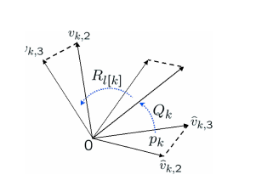

Pose Deformation

Slide 14

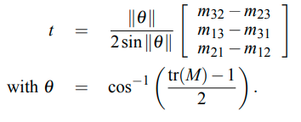
Pose Deformation
Learning the pose deformation model
Initial objective :
Joint rotations are represented with their twist coordinates.
Let M denote any 3 × 3 rotation matrix, and let m_{ij} be its entry in i-th row and j-th column. The twist t for the joint angle is a 3D vector, and can be computed from the following formula :

Slide 15


Pose Deformation
Learning the pose deformation model
Learn a regression function for each triangle p_{k} , which predicts the transformation matrices Q ^{i} _{k} as a function of the twists of its two nearest joints, i.e.
Associate a 7×1 regression vector a_{k,lm} with each of the 9 values of the matrix Q, and write :

Slide 16

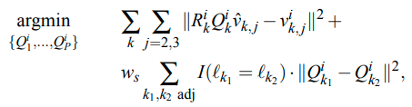
Pose Deformation
Learning the pose deformation model
Our goal now is to learn these parameters a_{k,lm}.
Unfortunately, the transformations Q ^{i} _{k} for the individual triangles are not known.
We follow Sumner et al. [2004] and Allen et al. [2003], and introduce a smoothness constraint which prefers similar deformations in adjacent polygons that belong to the same rigid part.

Slide 17


Body-Shape Deformation
Body-shape variation is applied independently of the pose variation, by introducing a new set of linear transformation matrices S^{i} _{k} , one for each instance i and each triangle k.
Similarly, objective function is given by :

Slide 18

Shape Completion
We are given sparse information about an instance mesh, and wish to construct a full mesh consistent with this information.
Assume we have a set of markers Z = z₁,...,z_{L} which specify known positions in 3D for some points x₁,..., x_{L} on the model mesh.
We want to find the set of points Y that best fits these known positions, and is also consistent with the SCAPE model.

Slide 19
Limitations
Mesh acquisition process is difficult and complex.
Suffers highly due to occlusions.
Deformations resulting from other factors are not encoded, like deformation due to pure muscle activity.
Tissue perturbations due to motion (like fat wiggling) is not captured.

